Slide 1
Capstone Project Mobile Price Range Prediction
Presented By :- PARAS

Slide 2
Problem statement
In the competitive mobile phone market companies want to understand sales data of mobile phones and factors which drive the prices.
The objective is to find out some relation between features of a mobile phone(e.g. :- RAM, Internal Memory, etc.) and its selling price. In this problem, we do not have to predict the actual price but a price range indicating how high is the price.

Slide 3
Data description
The data contains information regarding mobile phone features, specifications etc. and their price range.
The various features and information can be used to predict the price range of a mobile phone.
Mobile features such as -> battery power, ram, front/back camera MP, screen size, Bluetooth, weight, 4G/3G, etc.

Slide 4
Perform Exploratory Data Analysis (EDA)
Prepare data for Modeling
Build a model
Evaluate the model
Data Architecture
Experiment with different models
Validate Models
Select the final model
Evaluate the final model using test data

Slide 5
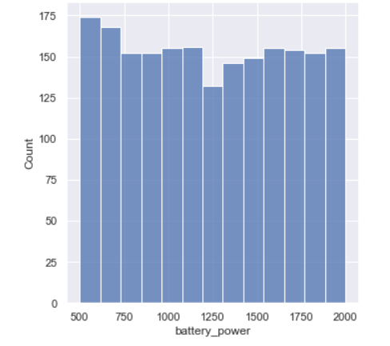
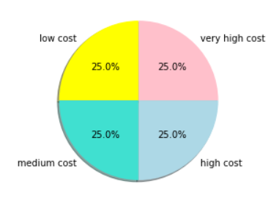
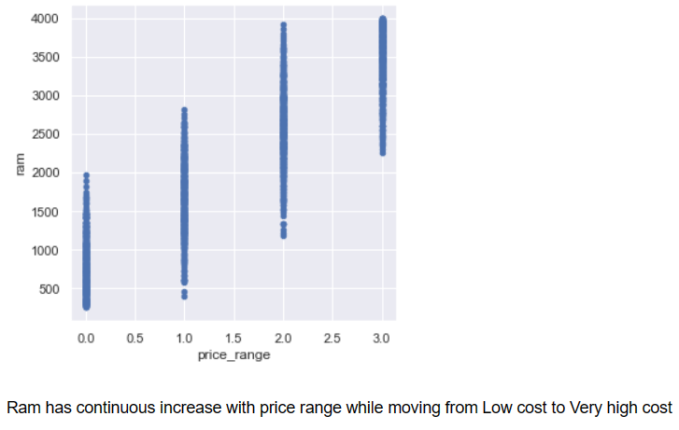
Data Analysis
Phone

Slide 6
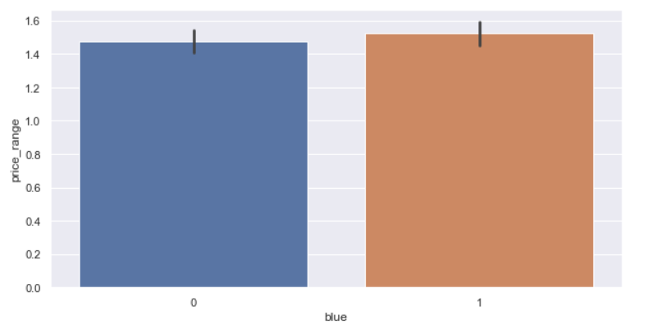
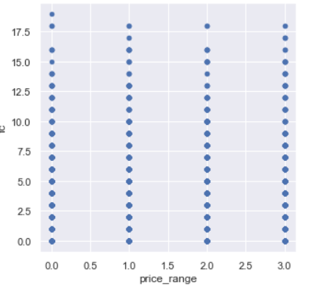
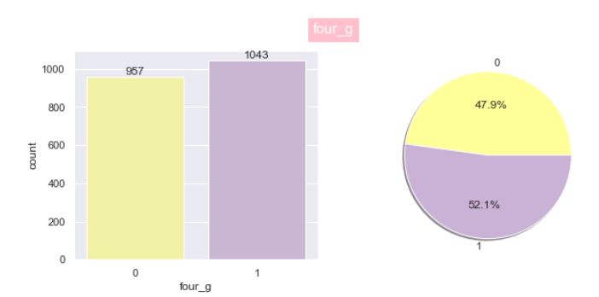
Front Camera
Bluetooth

Slide 7
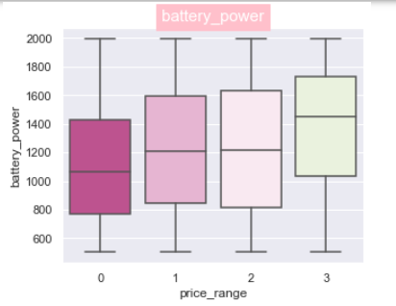
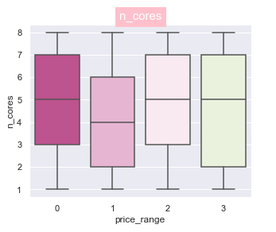
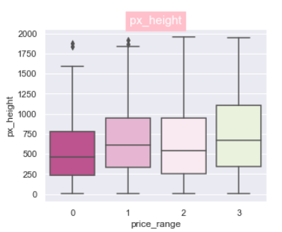
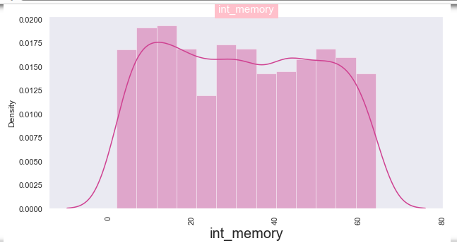

Slide 8
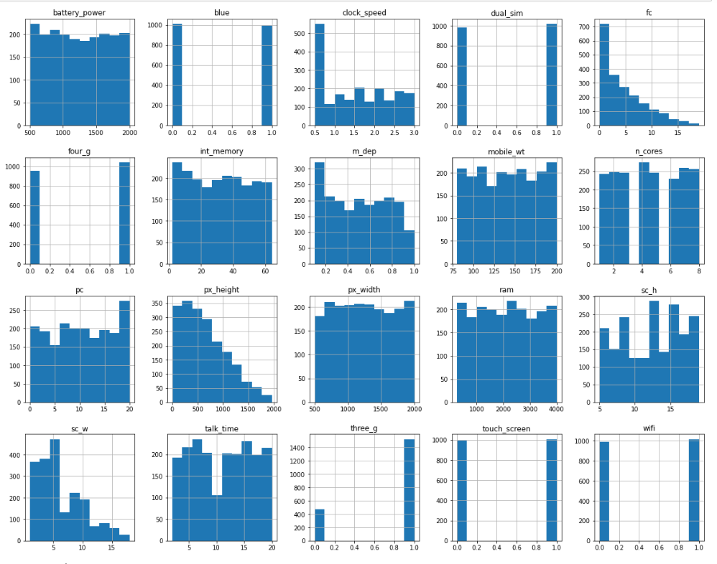
DATA DISTRIBUTION

Slide 9
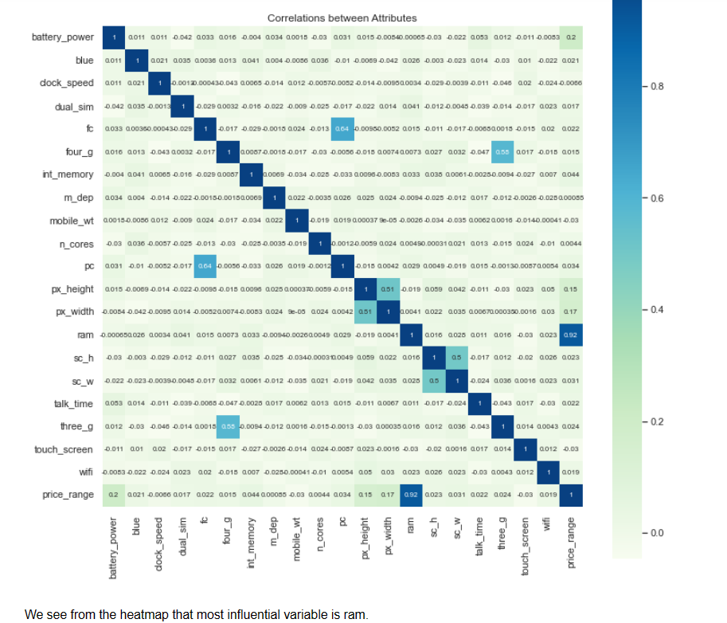
Heat map
RAM and price_range shows high correlation which is a good sign, it signifies that RAM will play major deciding factor in estimating the price range.

Slide 10
ML algorithms
Logistic Regression
Decision Tree Classifier
Random Forest Classifier
KNN Classifier
SVM Classifier
Naïve Bayes Classifier

Slide 11
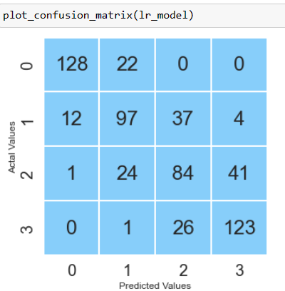
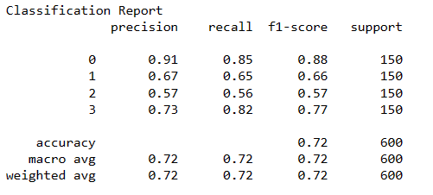
Logistic Regression

Slide 12
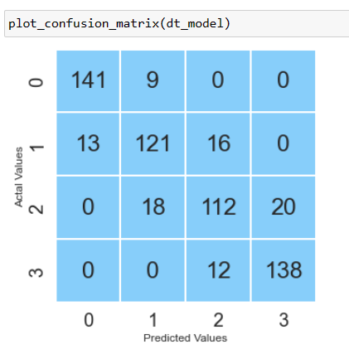
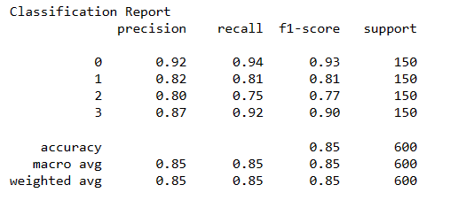
Decision Tree Classifier

Slide 13
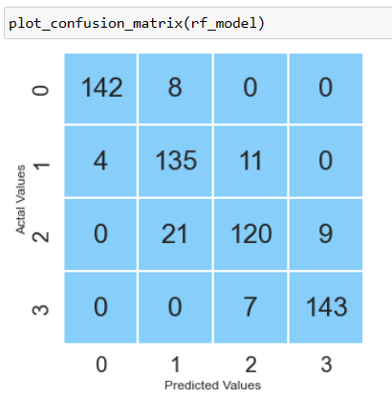
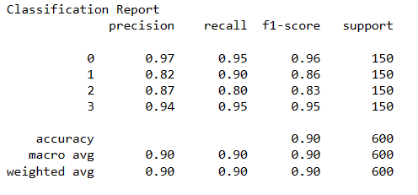
Random Forest Classifier

Slide 14
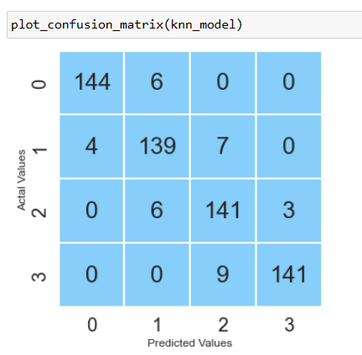
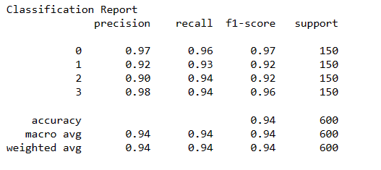
KNN Classifier

Slide 15
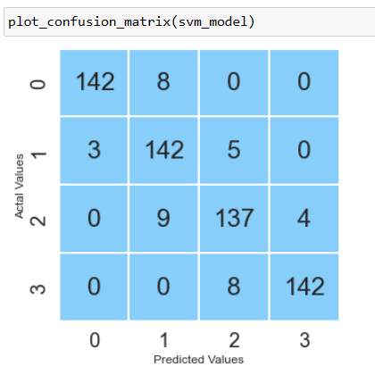
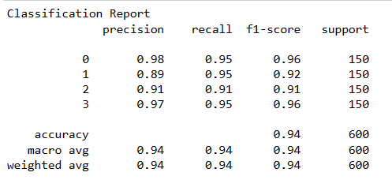
SVM Classifier

Slide 16
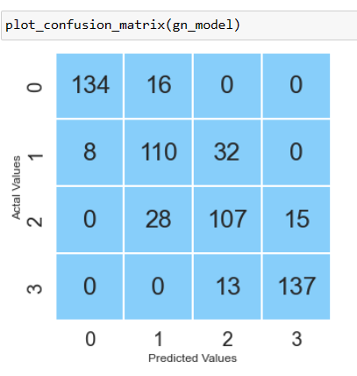
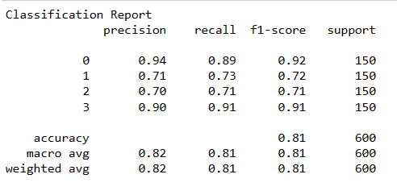
Naïve Bayes Classifier

Slide 17
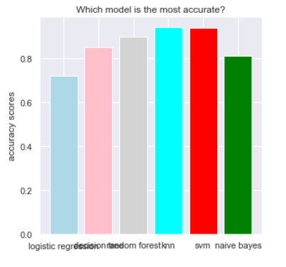
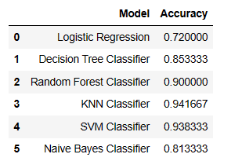
Comparison of Algorithm Accuracies

Slide 18
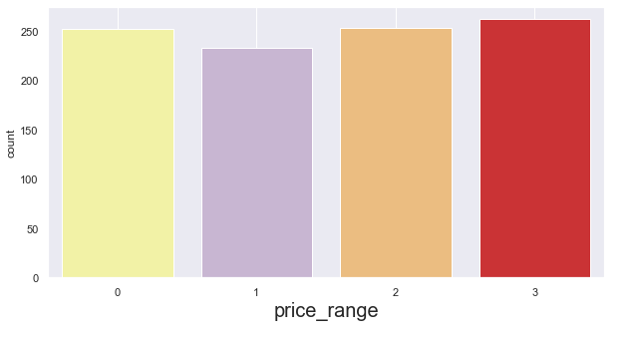
Mobile Phone Price Range based on new data

Slide 19
Conclusion
From EDA we can see that here are mobile phones in 4 price ranges. The number of elements is almost similar.
Half the devices have Bluetooth, and half don’t.
Ram has continuous increase with price range while moving from Low cost to Very high cost costly phones are lighter.
RAM, battery power, pixels played more significant role in deciding the price range of mobile phone.
form all the above experiments we can conclude that KNN classifier and SVM classifier we got the best results.
The accuracy and performance of the model is evaluated by using confusion matrix.

Slide 20
​THANK YOU

